Slide 1


Comprehensive Digital Marketing for wipro ﻿
Submitted by: A. Rajeswari [ Team Leader]
Brand Research, Competitors Analysis
K. Sateesh Vasista
Competitors and Customer Analysis
D.Srihari
Content idea Generated &Strategy
K. Bharath chandra
Performances and Sales

Slide 2
Market Research
Industry Trends
We conducted thorough research on the latest trends in the digital marketing industry opportunities for growth and innovation.
Customer Needs
Through surveys and focus groups, we gained insights into the needs and preferences of our target audience to inform our marketing strategy.

Slide 3

Target Audience
Identifying and understanding the target audience is a crucial aspect of any successful digital marketing campaign. For Wipro, the target audience may very depending on the specific product or service being marketed. However, some general characteristics of the target audience may include:
It decision makers in medium to large enterprises
Business leaders and executives
Technology enthusiasts and early adopters

Slide 4
Competitor Analysis
Competitor Identification
Identifying competitors is the first step in conducting a competitor analysis . We will identify direct and indirect competitors who are currently in the market and those who may enter the market in the future.
Competitors Strengths and Weaknesses
We will conduct a SWOT analysis to assess the strengths, weaknesses, opportunities, and threats of our competitors. This will help us identify areas where we can differentiate ourselves and capitalize on our strengths.
Competitor Marketing Strategies
We will analyze the marketing strategies of our competitors, including their messaging, branding, and channels. This will help us identify areas where we can differentiate ourselves and develop a unique value proposition.

Slide 5
Marketing Channels
Social Media
with the rise of social media, it is important for Wipro to have a strong presence on various platforms. The following channels will be utilized:
Linked: Targeting professionals and B2B clients through thogth leadership content and sponsored posts.
Twitter: Sharing company updates, industry news, and engaging with potential clients and influencers.

Slide 6

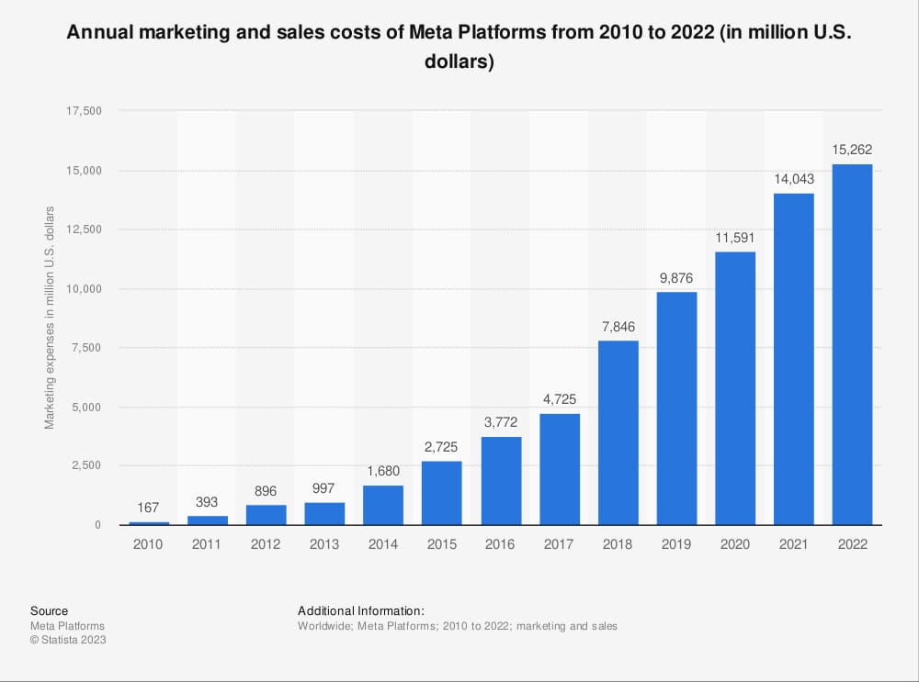
Annual marketing and sales costs of meta platform from 2010 to 2022 (in million U.S dollars)

Slide 7

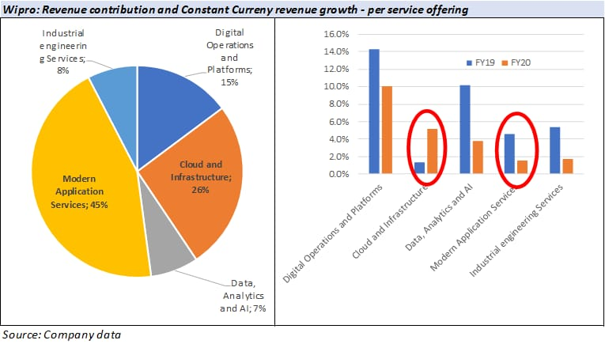

Slide 8
Thank You
We wanted to express our gratitude for the comprehensive digital marketing that we developed for Wipro. Our team's hard work and dedication have resulted in a significant increase in online visibility and sales.

